Slide 1
PROGRAM : COMPUTER ENGINEERING
SEM : I
YEAR : 1ST
COURSE : ENGINEERING GRAPHICS
COURSE CODE : ENG198904
NAME OF THE FACULTY: SHARYU R. KADAM

Slide 2
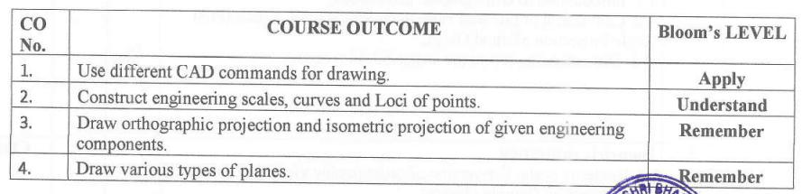
CO’S

Slide 3
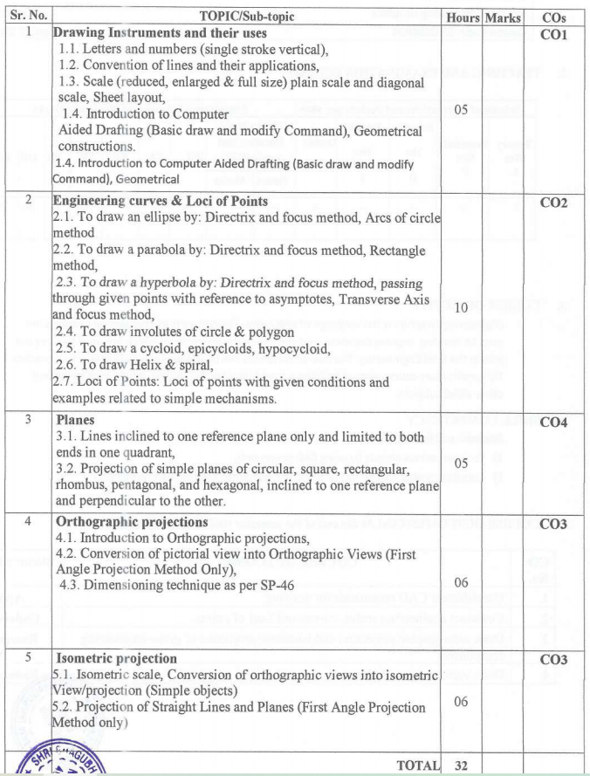

Slide 4
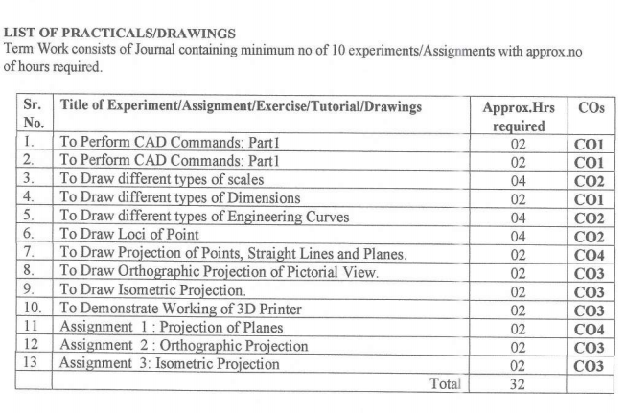

Slide 5
CH- 2 Engineering Curves

Slide 6

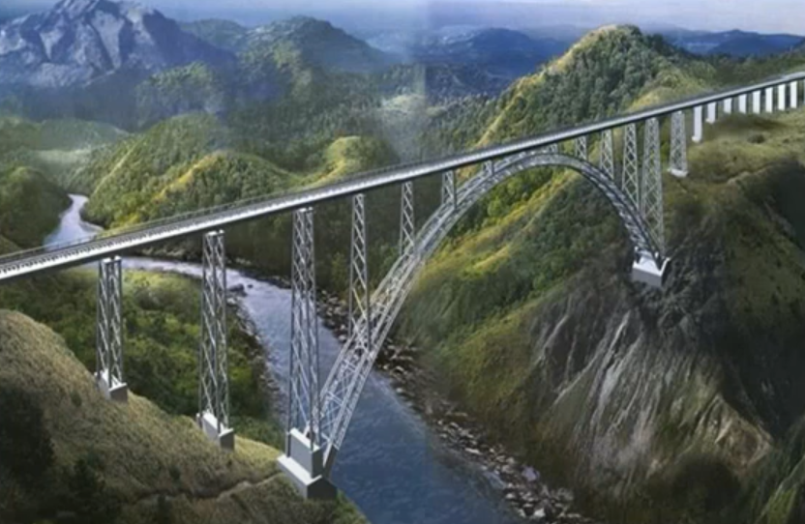
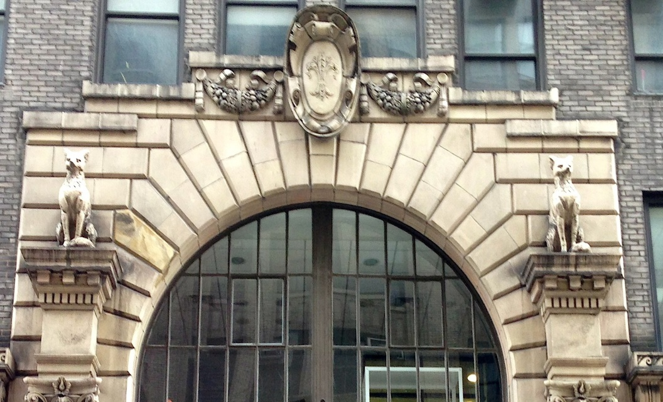
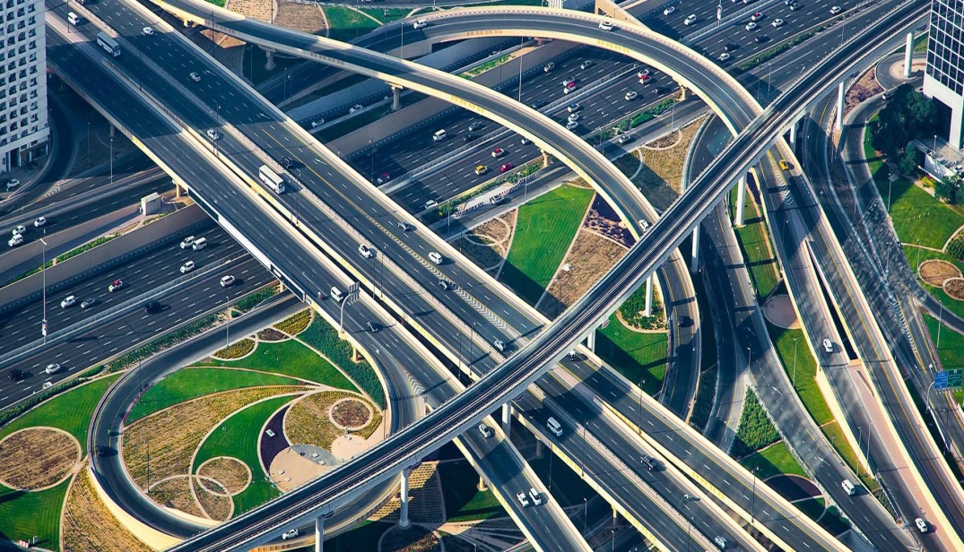
Railway tunnel
Bridges
Building
Highways

Slide 7
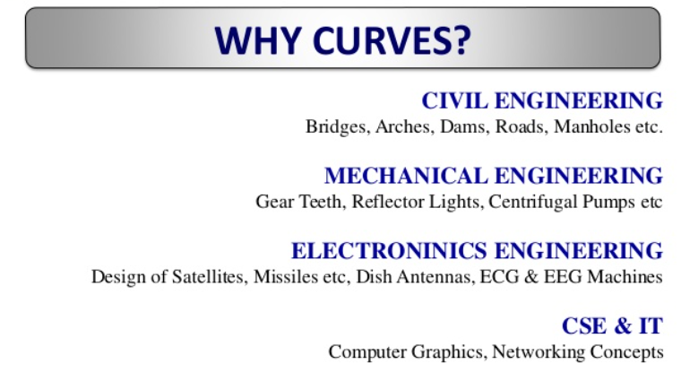

Slide 8
Engineering Curves
The curves obtained by the intersection of a cone by cutting plane in different position is called as engineering curves or conics.
https://www.youtube.com/watch?v=FXP3tKedM5g

Slide 9
Engineering Curves :
Ellipse
Parabola
Hyperbola
Cycloid
Epicycloid
Hypocycloid
Involutes
Helix
spiral

Slide 10
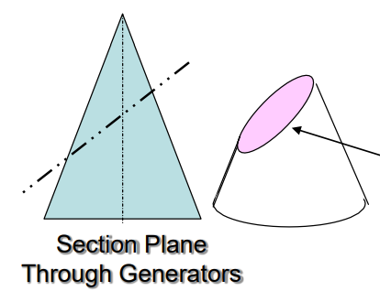

Ellipse
A regular oval shape , traced by a point moving in a plane so that sum of distances from two other point is same.

Slide 11
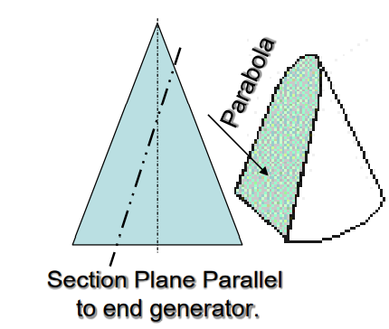
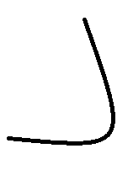
Parabola
It is a symmetrical plane curved formed by the intersection of a cone with a plane parallel to its side. The path of a projectile under the influence of gravity follows a curve of this shape.

Slide 12
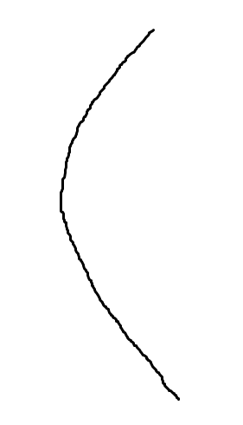
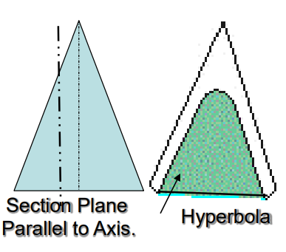
Hyperbola
A symmetrical open curve formed by the intersection of circular cone with a plane at a smaller angle with its axis than the side of cone

Slide 13
Methods to draw engineering curves:
Directrix circle method
Arc of circle method
Rectangle method
Concentric circle method.

Slide 14
Directrix circle method
Focus : It is a fixed point
Directrix : It is a fixed straight Line
Axis : It is a fixed straight Line at right angles to directrix and passing through the focus
Vertex : It is a point where conic intersects the axis.
Eccentricity : It is a ratio of the distance of moving point from the focus to its distance from the directrix. It is denoted by ‘e’
Eccentricity (e)
=
Distance of the point from the focus (VF)
Distance of the point from the directrix (VC)
Directrix
Focus point
Ellipse : e < 1
V
C
F
Hyperbola : e > 1
Parabola : e = 1
VC
VF

Slide 15
Ellipse : e < 1
E
Parabola : e = 1
Directrix
Directrix
E
Focus point
Focus point
C
C
F
F
V
V
VC
VF
VC
VF
E
Directrix
Focus point
C
F
V
VC
VF
Hyperbola : e > 1

Slide 16
Problem 1 :
Construct an ellipse when the distance of focus from the directrix is 50 mm and eccentricity is 2/3
Given data : Focus Point F = 50 mm , eccentricity =
VF
=
2
VC
3
1.Draw a directrix AB with suitable length
2.Draw with suitable length (approximately double of the focus of point F )axis from directrix AB and assign name CD
50 mm (5 cm)
5’
3. Plot Focus of point F on axis from the directix at 50 mm distance.
4’
A
3’
2’
4. Mark a point V on axis according to eccentricity
1’
5. Draw a vertex VE from point V which is equal to VF.
E
6. Join CE and extend it..
7. Mark suitable number of division points on axis from point V.
1
2
3
4
C
5
D
8. Draw vertical lines from division points and assign numbering as per given in diagram.
V
F
3 cm
2 cm
9. Take 1 – 1’ as a radius and F as a center point mark the points upper and down side on first line
9.1 Take 2 – 2’ as a radius and F as a center point mark the points upper and down side on first line
10. Repeat step no. 9 for all the division points.
B
11. Join arc point and construct an ellipse.

Slide 17
Problem 2 :
Construct an ellipse when the distance of focus from the directrix is 70 mm and eccentricity is 3/4
Given data : Focus Point F = 70 mm , eccentricity =
VF
=
3
VC
4
1.Draw a directrix AB with suitable length
2.Draw with suitable length (approximately double of the focus of point F )axis from directrix AB and assign name CD
5’
3. Plot Focus of point F on axis from the directix at 70 mm distance.
4’
3’
4. Mark a point V on axis according to eccentricity
2’
5. Draw a vertex VE from point V which is equal to VF.
A
1’
6. Join CE and extend it..
E
7. Mark suitable number of division points on axis from point V.
8. Draw vertical lines from division points and assign numbering as per given in diagram.
C
1
2
3
4
D
9. Take 1 – 1’ as a radius and F as a center point mark the points upper and down side on first line
F
0
V
9.1 Take 2 – 2’ as a radius and F as a center point mark the points upper and down side on first line
10. Repeat step no. 9 for all the division points.
11. Join arc point and construct an ellipse.
B

Slide 18
Problem 2 :
A fixed point F is 80 mm from a fixed straight line AB. Draw parabola by using directrix focus method.
Given data : Focus Point F = 80 mm , eccentricity =
VF
=
4
VC
4
1.Draw a directrix AB with suitable length
4’
2.Draw with suitable length (approximately double of the focus of point F )axis from directrix AB and assign name CD
3’
3. Plot Focus of point F on axis from the directix at 80 mm distance.
2’
1’
4. Mark a point V on axis according to eccentricity
5. Draw a vertex VE from point V which is equal to VF.
A
E
6. Join CE and extend it..
7. Mark suitable number of division points on axis from point V.
8. Draw vertical lines from division points and assign numbering as per given in diagram.
C
1
2
3
4
D
9. Take 1 – 1’ as a radius and F as a center point mark the points upper and down side on first line
V
F
9.1 Take 2 – 2’ as a radius and F as a center point mark the points upper and down side on first line
10. Repeat step no. 9 for all the division points.
11. Join arc point and construct an ellipse.
B

Slide 19
Problem 2 :
3’
The distance between a fixed straight line and fixed focus point is 80 mm. Draw a Hyperbola , if eccentricity is 5/3
Given data : Focus Point F = 80 mm , eccentricity =
VF
=
5
VC
3
2’
1.Draw a directrix AB with suitable length
2.Draw with suitable length (approximately double of the focus of point F )axis from directrix AB and assign name CD
4’
1’
3. Plot Focus of point F on axis from the directix at 80 mm distance.
4. Mark a point V on axis according to eccentricity
5. Draw a vertex VE from point V which is equal to VF.
A
E
6. Join CE and extend it..
7. Mark suitable number of division points on axis from point V.
8. Draw vertical lines from division points and assign numbering as per given in diagram.
D
9. Take 1 – 1’ as a radius and F as a center point mark the points upper and down side on first line
1
2
3
C
4
9.1 Take 2 – 2’ as a radius and F as a center point mark the points upper and down side on first line
V
F
10. Repeat step no. 9 for all the division points.
11. Join arc point and construct an ellipse.
B

